Slide 1
Cloud-based IoT platform for real-time data processing
Submitted by
Y.Sruthi
192211583

Slide 2
objective
The objective of developing a Cloud-Based IoT Platform for Real-Time Data Processing is to create a scalable and resilient infrastructure that can efficiently ingest, process, store, and visualize data from diverse IoT devices in real-time.
This platform aims to address challenges such as scalability issues, latency concerns, and the need for advanced analytics and machine learning integration to derive actionable insights.
By leveraging cloud services and robust architectural design, the goal is to provide a secure and efficient solution that supports seamless integration of IoT devices, ensures data integrity, and enhances operational efficiency across various industry applications

Slide 3
Introduction
The Internet of Things (IoT) has revolutionized industries by enabling connectivity and data generation from diverse devices.
Challenges include scalability, real-time processing, and deriving actionable insights from vast data volumes.
Traditional IoT platforms often struggle with processing real-time data and integrating diverse sources securely.
Cloud-based solutions offer scalable infrastructure and advanced analytics capabilities to address these challenges effectively.
This presentation explores the design, implementation, and benefits of a cloud-based IoT platform for real-time data processing.

Slide 4
Proposed Architecture Design
1.Identifying Key Components
IoT Core:
AWS IoT Core, Azure IoT Hub, or Google Cloud IoT Core for device connectivity and secure data ingestion.
Data Ingestion:
Protocols: MQTT, HTTP, or Web Sockets.
Security: Authentication (X.509 certificates), encryption (TLS), and access control (IAM policies).
Stream Processing:
Message Queues: AWS Kinesis, Azure Event Hubs, or Google Pub/Sub.
Frameworks: Apache Kafka, Apache Flink, or AWS Kinesis Data Analytics.
Storage:
Databases: NoSQL (Dynamo DB, Cosmos DB, Firestore), Time-series databases (Amazon Time stream, Influx DB).

Slide 5
Analytics and Machine Learning:
Frameworks: Tensor Flow, PyTorch.
Services: AWS Sage Maker, Azure Machine Learning, or Google AI Platform.
Visualization:
Tools: AWS Quick Sight, Azure Power BI, Google Data Studio.
Scalability and Performance:
Auto-scaling and Load Balancing: AWS Auto Scaling, Azure Scale Sets, Google Cloud Load Balancing.
Monitoring and Management:
Tools: AWS Cloud Watch, Azure Monitor, Google Cloud Operations Suite.

Slide 6
2.Functionality
Data Ingestion:
Secure, real-time data ingestion from IoT devices using standard protocols.
Authentication and encryption for data security.
Real-Time Processing:
Real-time data processing for cleansing, filtering, aggregation, and enrichment.
Handles high-velocity data streams with minimal latency.
Storage:
Efficient storage for raw and processed data.
Supports NoSQL and time-series databases.
Advanced Analytics:
Machine learning for predictive analytics, anomaly detection, and pattern recognition.
Pre-built models and custom model deployment.
Scalability and Performance:
Horizontal scaling and load balancing for increased data volumes and user demand.

Slide 7
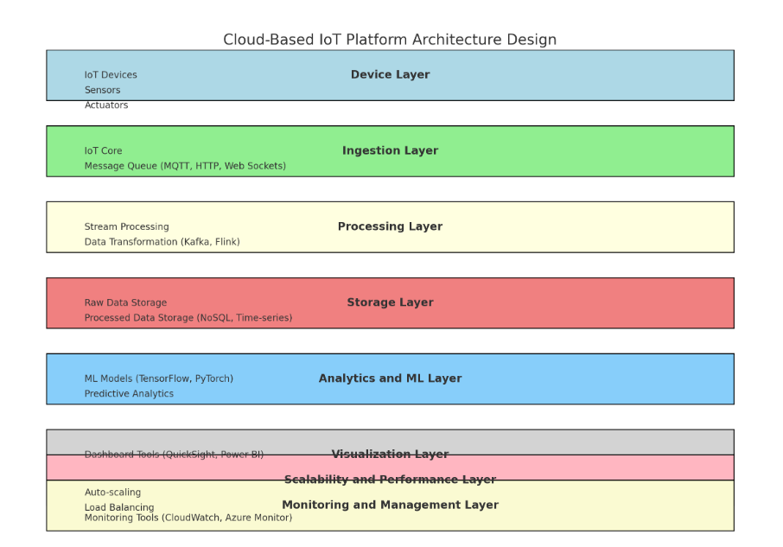
Architectural Design

Slide 8
Architectural Design
Device Layer:
IoT Devices with connectivity using MQTT, HTTP, or Web Sockets.
Ingestion Layer:
IoT Core and Message Queues (AWS Kinesis, Azure Event Hubs, Google Pub/Sub).
Processing Layer:
Stream Processing (Apache Kafka, Flink, AWS Kinesis Data Analytics).
Data Transformation.
Storage Layer:
Raw Data and Processed Data Storage (NoSQL, time-series databases).
Analytics and Machine Learning Layer:
ML Models and Frameworks (Tensor Flow, PyTorch).
Visualization Layer:
Dashboard Tools (AWS Quick Sight, Azure Power BI, Google Data Studio).
Scalability and Performance Layer:
Auto-scaling and Load Balancing (AWS Auto Scaling, Azure Scale Sets, Google Load Balancing).
Monitoring and Management Layer:
Monitoring Tools (AWS Cloud Watch, Azure Monitor, Google Cloud Operations Suite).

Slide 9
Benefits
Scalability
Flexibility
Real time processing
Cost efficiency
Global reach
Security
Integration with AI and ML
Ease of Management

Slide 10
conclusion
In conclusion, the development of a cloud-based IoT platform involves meticulous planning, robust architecture design, proficient coding in Python, and strategic deployment on cloud infrastructure like AWS. Performance evaluation through rigorous testing ensures the platform's scalability, reliability, low latency, efficient resource utilization, and adherence to security standards. Continuous monitoring and optimization are essential to maintain peak performance and user satisfaction, making the platform capable of delivering actionable insights from diverse IoT data sources effectively.

